Slide 1
Growing Configurable Software with Expression<T>
Ed Courtenay

Slide 2
Introduction
Technical Architect & Evangelist
25 Years Experience
Infrequent Blogger
http://www.edcourtenay.co.uk
@edcourtenay

Slide 3
Agenda
Demonstrate base filtering solution
Convert filter to Func<T,bool>
Convert filter to Expression<Func<T,bool>>
Compile filter to method

Slide 4
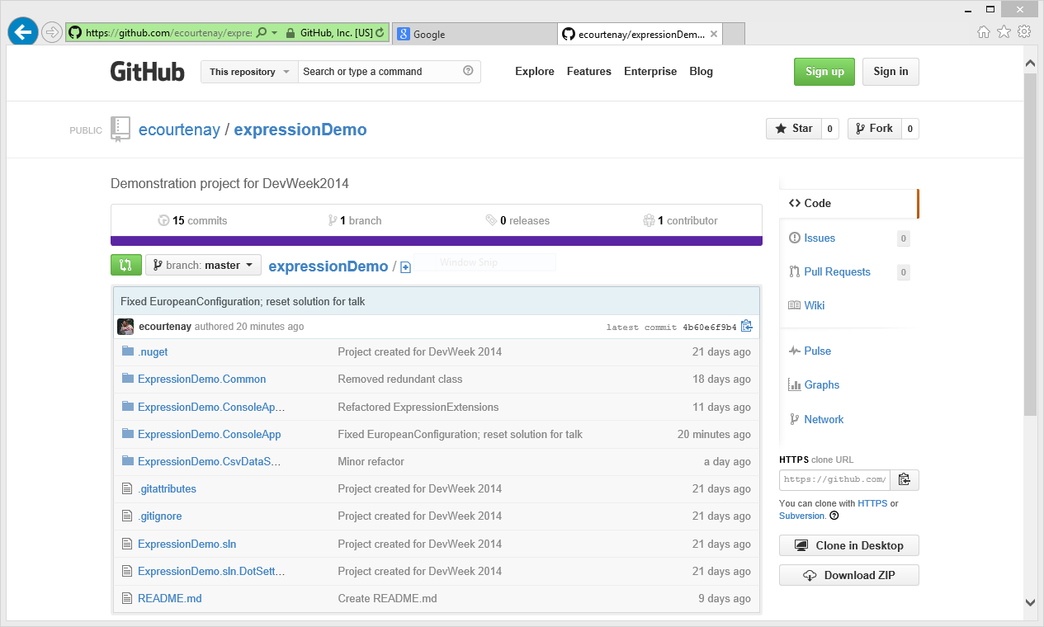
GitHub Source

Slide 5
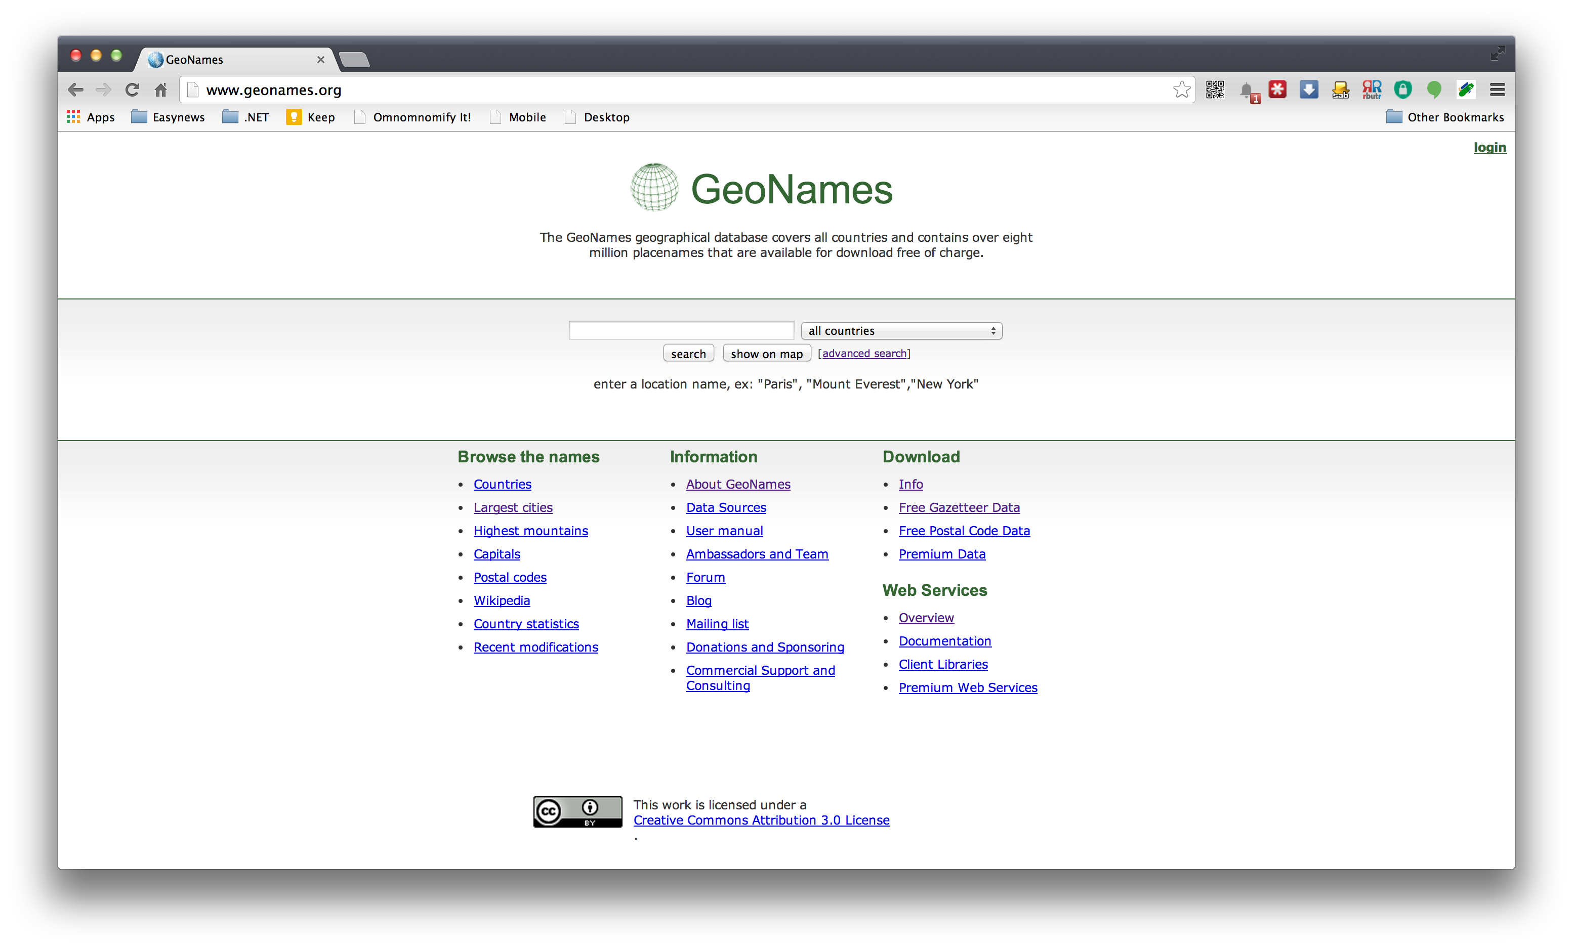
GeoNames
Notes:
----- Meeting Notes (14/03/2014 10:47) -----

Slide 6
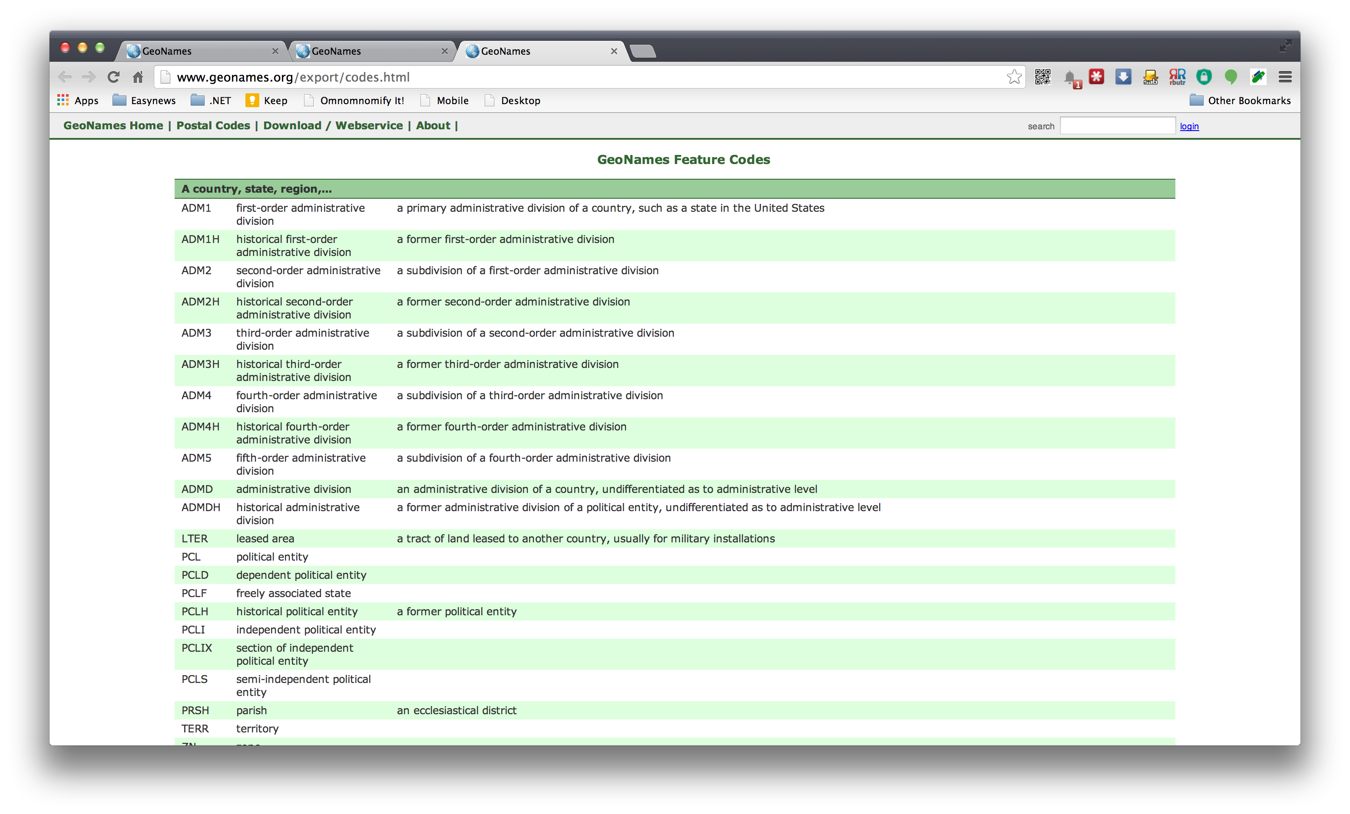
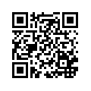
GeoNames

Slide 7
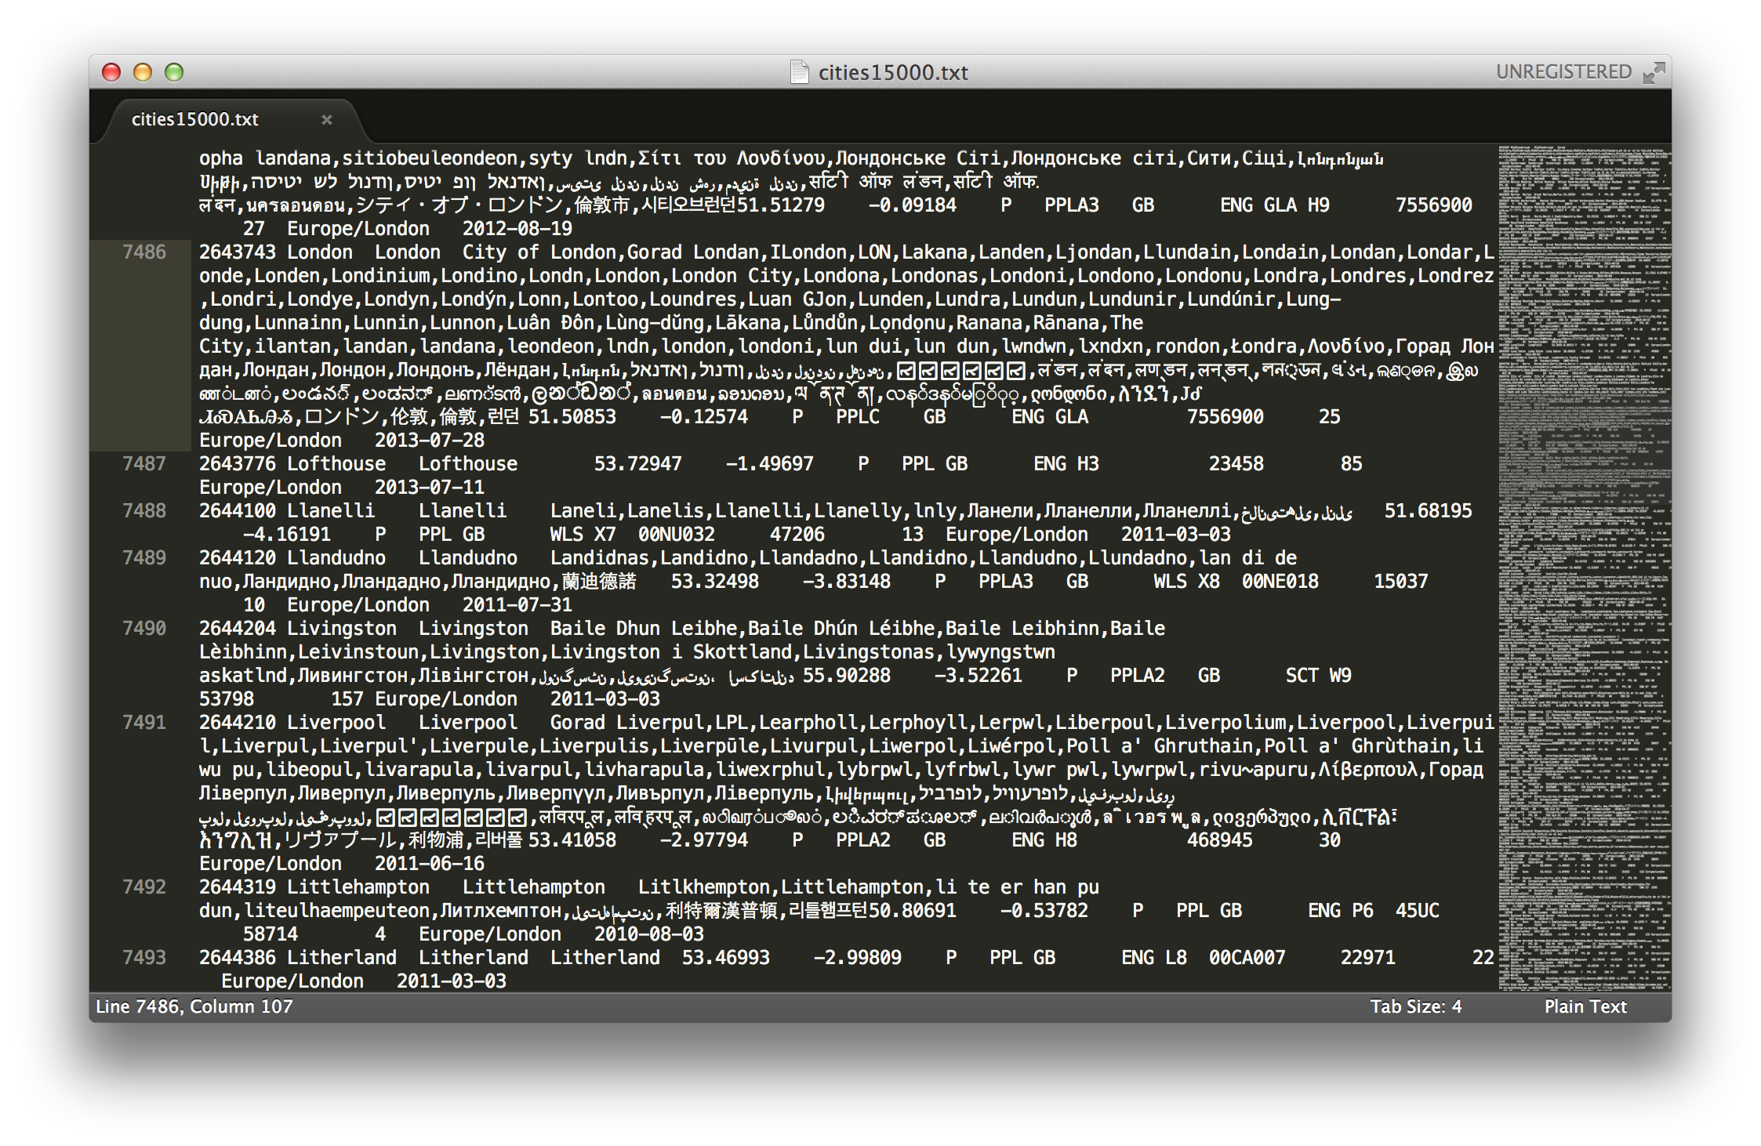
GeoNames

Slide 8
Process Flow
Read
IEnumerable<IGeoLocationData>
Filter
SimpleFilter
Count
EuropeanConfiguration

Slide 9
Demo
Simple Filter

Slide 10
Simple Filter
Difficult to cache rules
Configuration settings evaluated on every pass

Slide 11
What are Expressions?
“Code as Data”
Model single operations
Can be combined into trees of expressions
Think of the XML DOM

Slide 12
Expression Types
BinaryExpression
BlockExpression
ConditionalExpression
ConstantExpression
DebugInfoExpression
DefaultExpression
DynamicExpression
GotoExpression
IndexExpression
InvocationExpression
LabelExpression
LambdaExpression
ListInitExpression
LoopExpression
MemberExpression
MemberInitExpression
MethodCallExpression
NewArrayExpression
NewExpression
ParameterExpression

Slide 13
Expression Types
RuntimeVariablesExpression
SwitchExpression
TryExpression
TypeBinaryExpression
UnaryExpression

Slide 14
BinaryExpression Types
Binary Arithmetic
Bitwise Operations
Add
AddChecked
Divide
Modulo
Multiply
MultiplyChecked
Power
Subtract
SubtractChecked
And
Or
ExclusiveOr

Slide 15
BinaryExpresion Types
Comparison Operations
Conditional Boolean
Equal
NotEqual
GreaterThanOrEqual
GreaterThan
LessThan
LessThanOrEqual
AndAlso
OrElse

Slide 16
1+1=?
Add
1
1

Slide 17
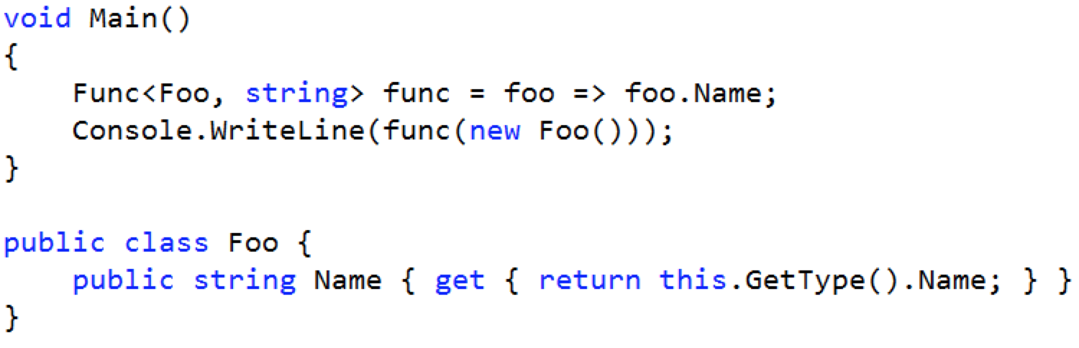
Converting lambdas to Expressions

Slide 18
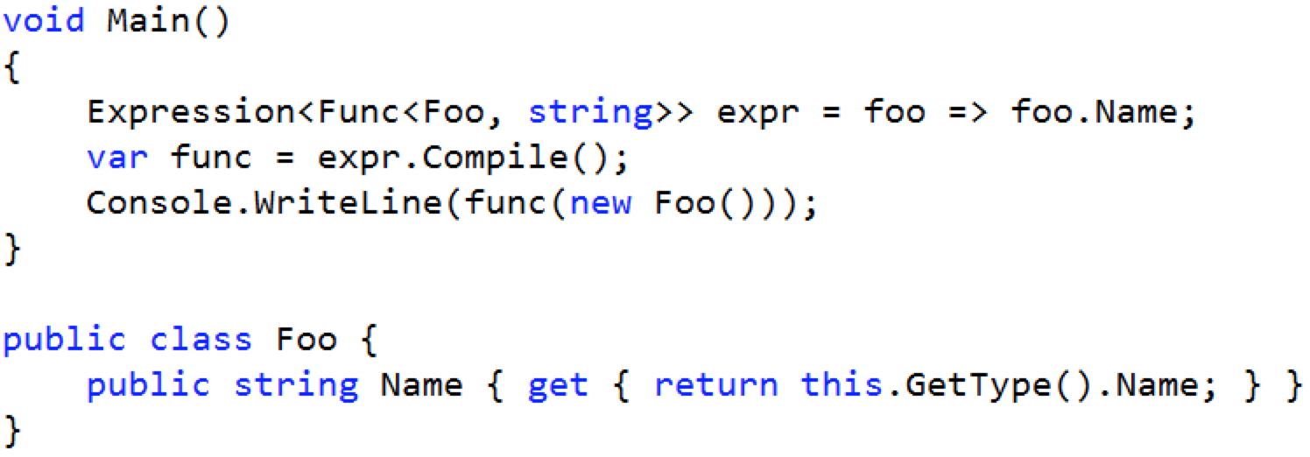
Converting lambdas to Expressions

Slide 19
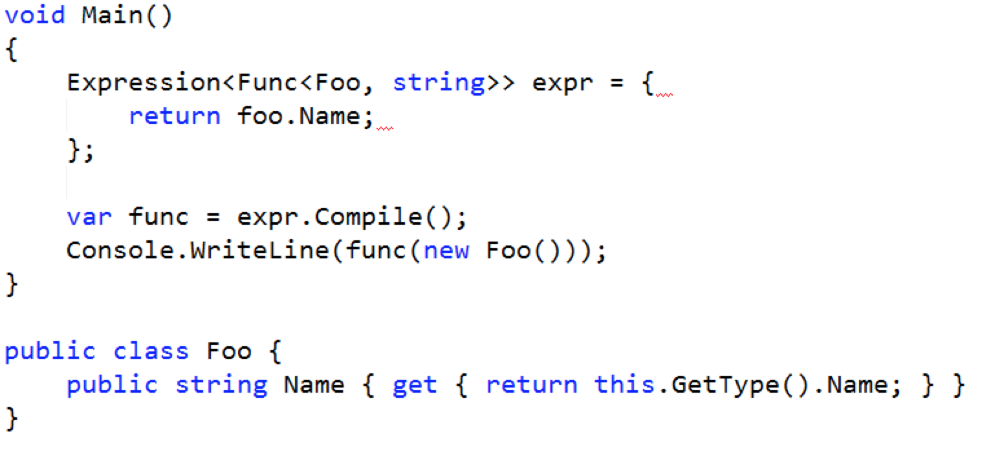
But…

Slide 20
Common Limitations
Cannot convert a block of statements
Has to evaluate to a single Expression
Expression cannot contain assignments

Slide 21
Combining Expressions
Expression
Or
Expression
Or
Expression

Slide 22
Combining Expressions
Or
Or
Expression
Expression
Expression

Slide 23
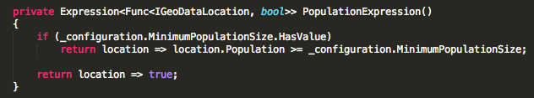

Slide 24
GreaterThanOrEqual
Constant
Property

Slide 25


Slide 26
So, why bother?
Encapsulation of Business Rules
As part of a build process
Rules rarely change during application lifetime
Domain Specific Language parser
Reverse Polish Notation calculator

Slide 27
Demo
Reverse Polish Notion Calculator

Slide 28
2 2 +
Add
2
2

Slide 29
3 2 2 + *
Multiply
3
Add
2
2

Slide 30
512 1 12 4 / / ^ 4 - 2 ^
Power
Subtract
Power
512
4
2
Divide
1
Divide
12
4

Slide 31
Source Code
ExpressionDemo solution available on GitHub
https://github.com/ecourtenay/expressionDemo.git
GeoNames
http://download.geonames.org/export/dump

Slide 32
Any Questions?

